Slide 1
Applying for Pupil Premium

Slide 2
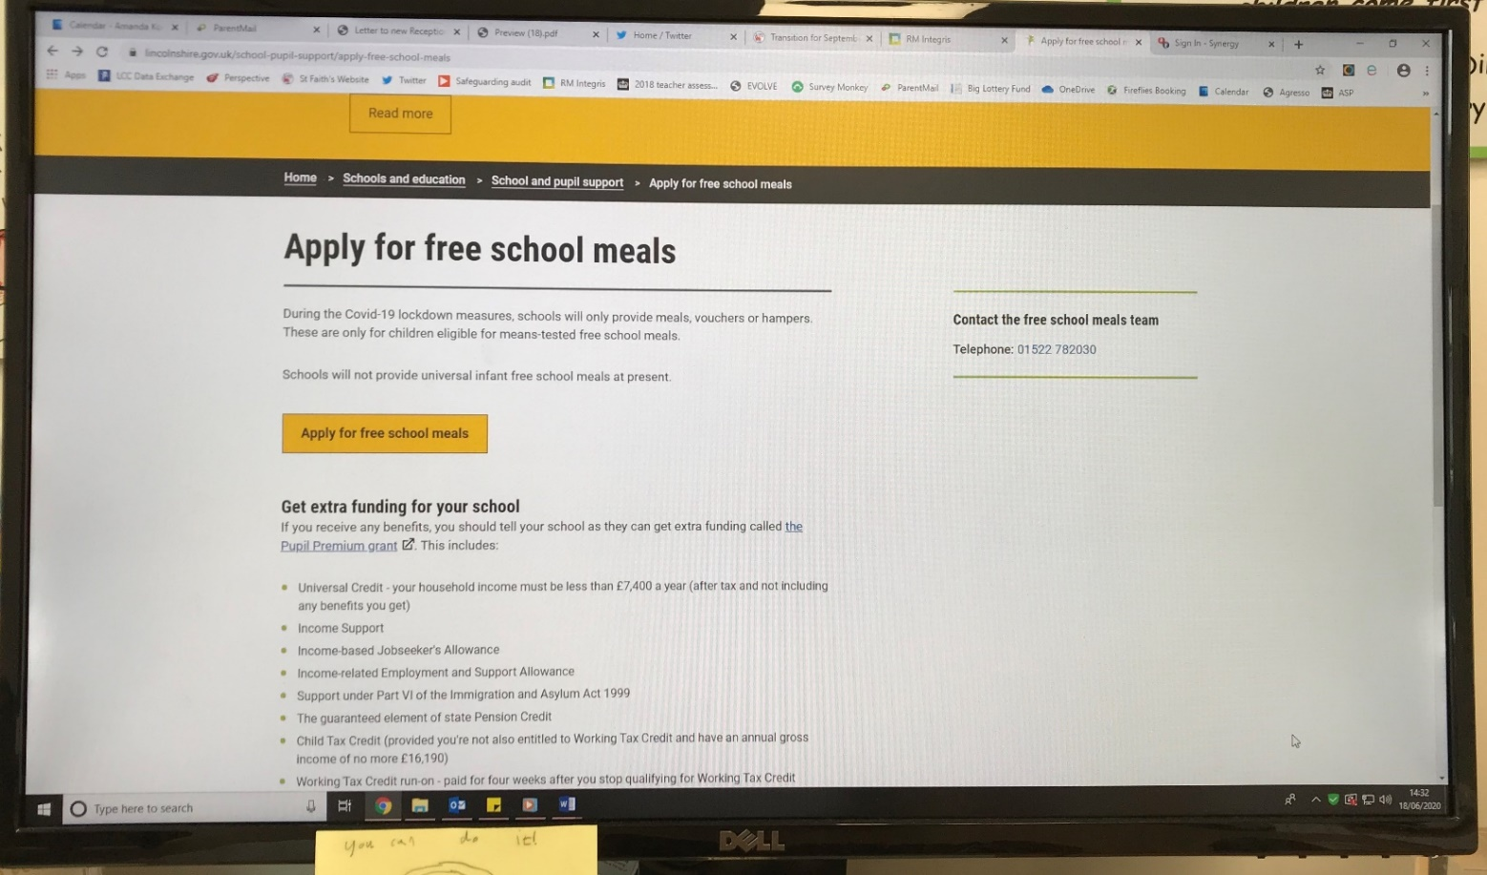
Go to https://www.lincolnshire.gov.uk/school-pupil-support/apply-free-school-meals

Slide 3
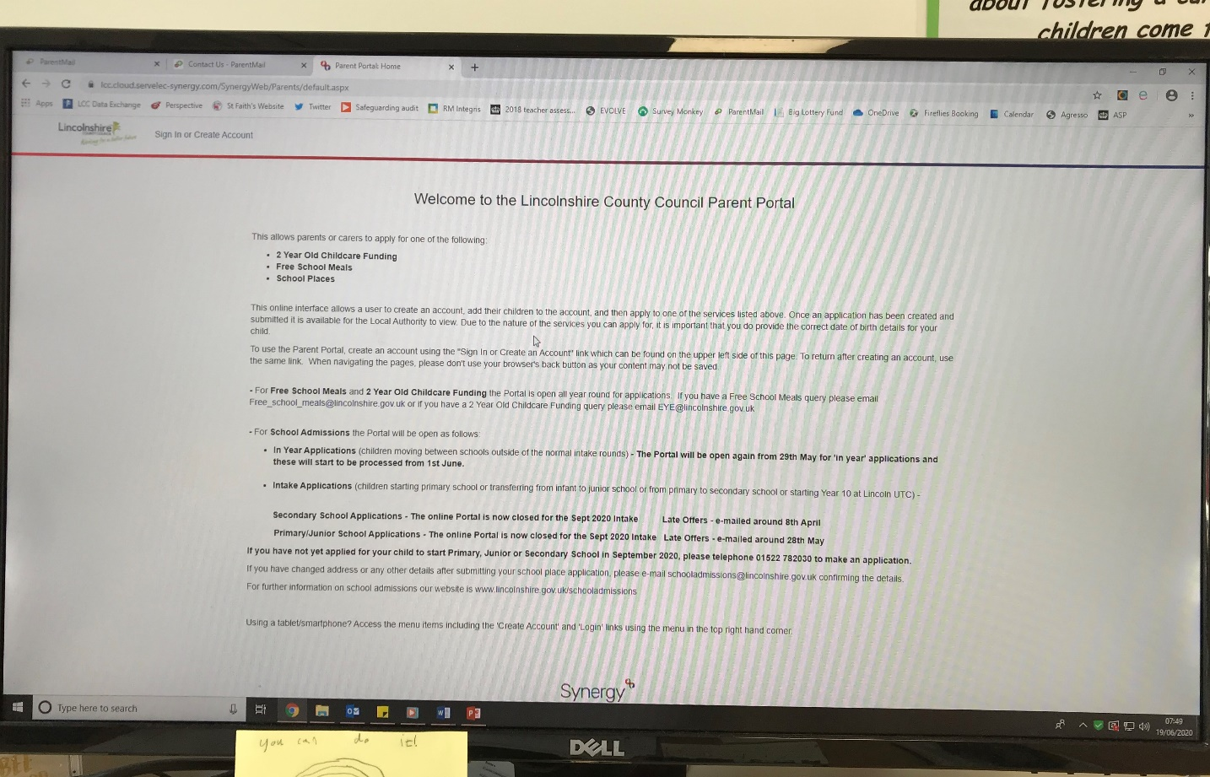

Welcome to the Lincolnshire County Council
Parent Portal.
In the top left hand corner (where the star is), sign in or create an account.

Slide 4
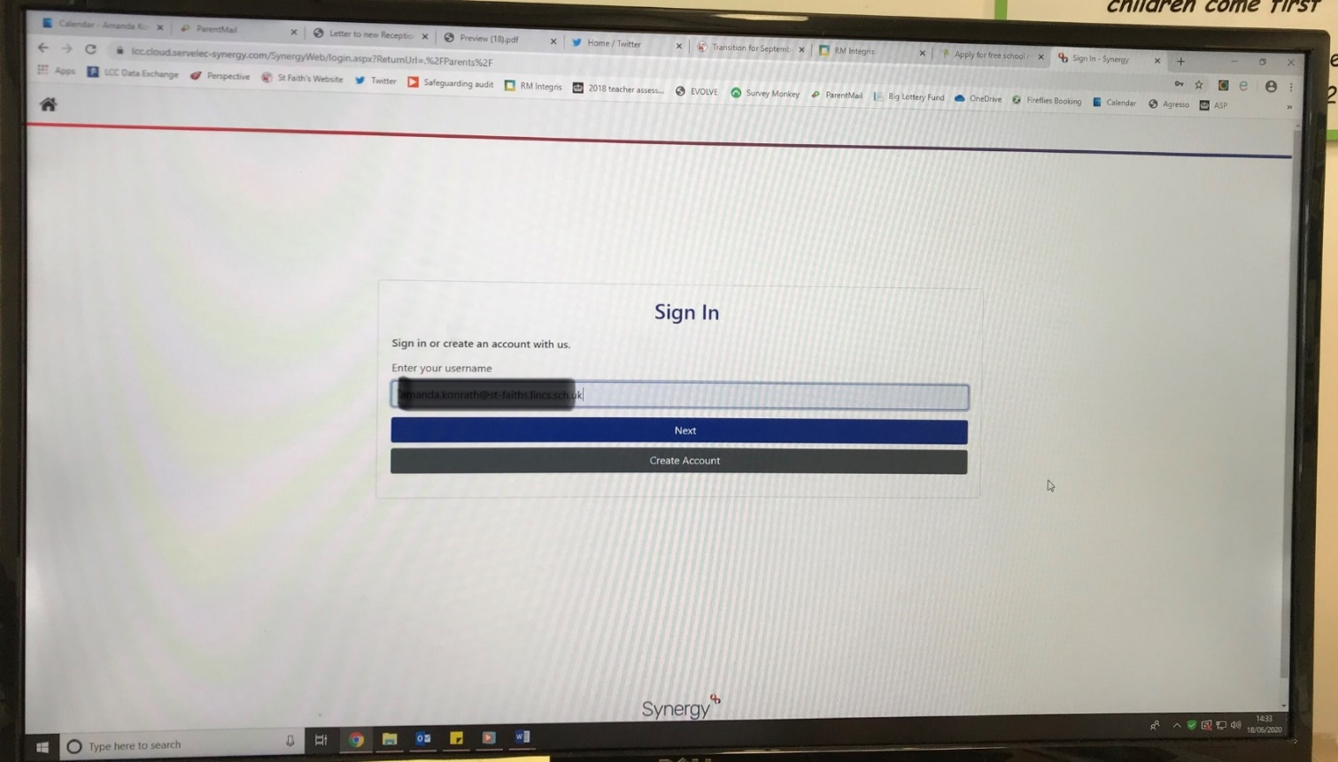
Put in your username. If you can’t remember it, mine was my email address. Try that!

Slide 5
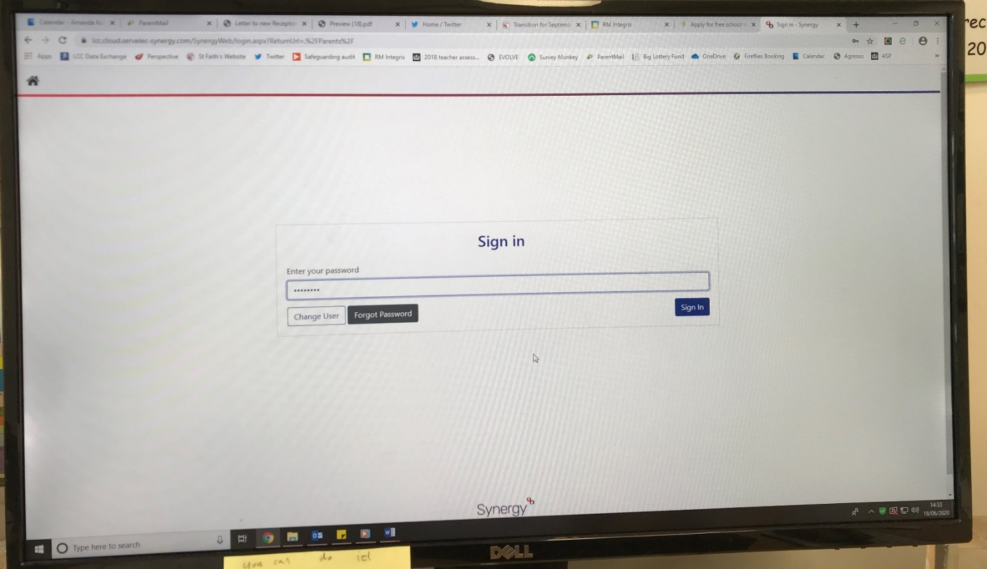
Enter your password. If you have forgotten it, click forgot password.

Slide 6
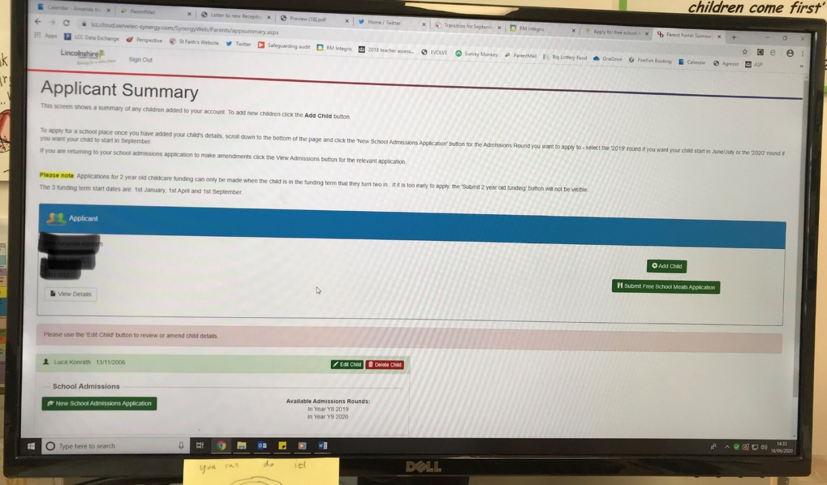
The Applicant Summary page has your child/children’s names on. Click on the submit free school meals application bar (where the star is)

Slide 7
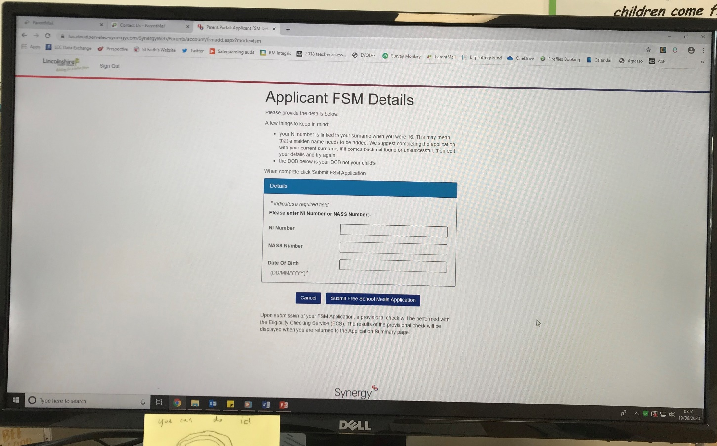
Applicant FSM detail.
Add your National Insurance number and your date of birth (not your child’s DOB).
Click Submit Free School Meals Application.

Slide 8
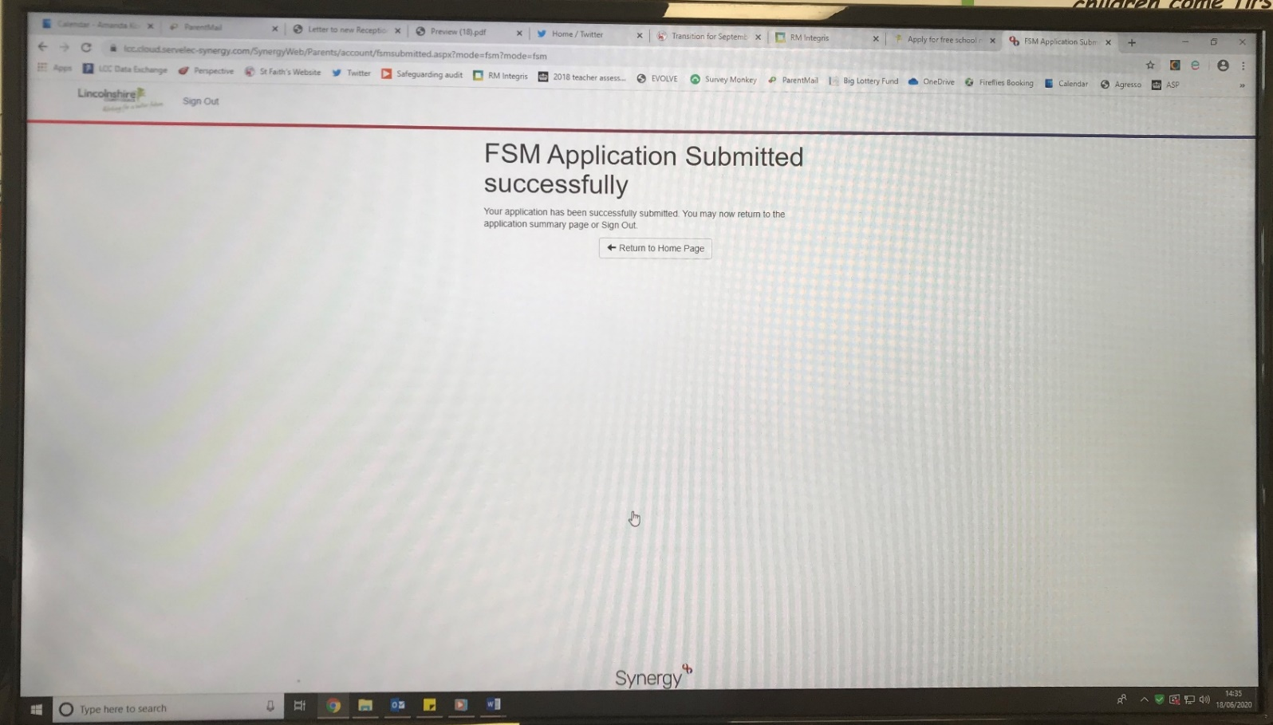
The screen below will appear.

Slide 9
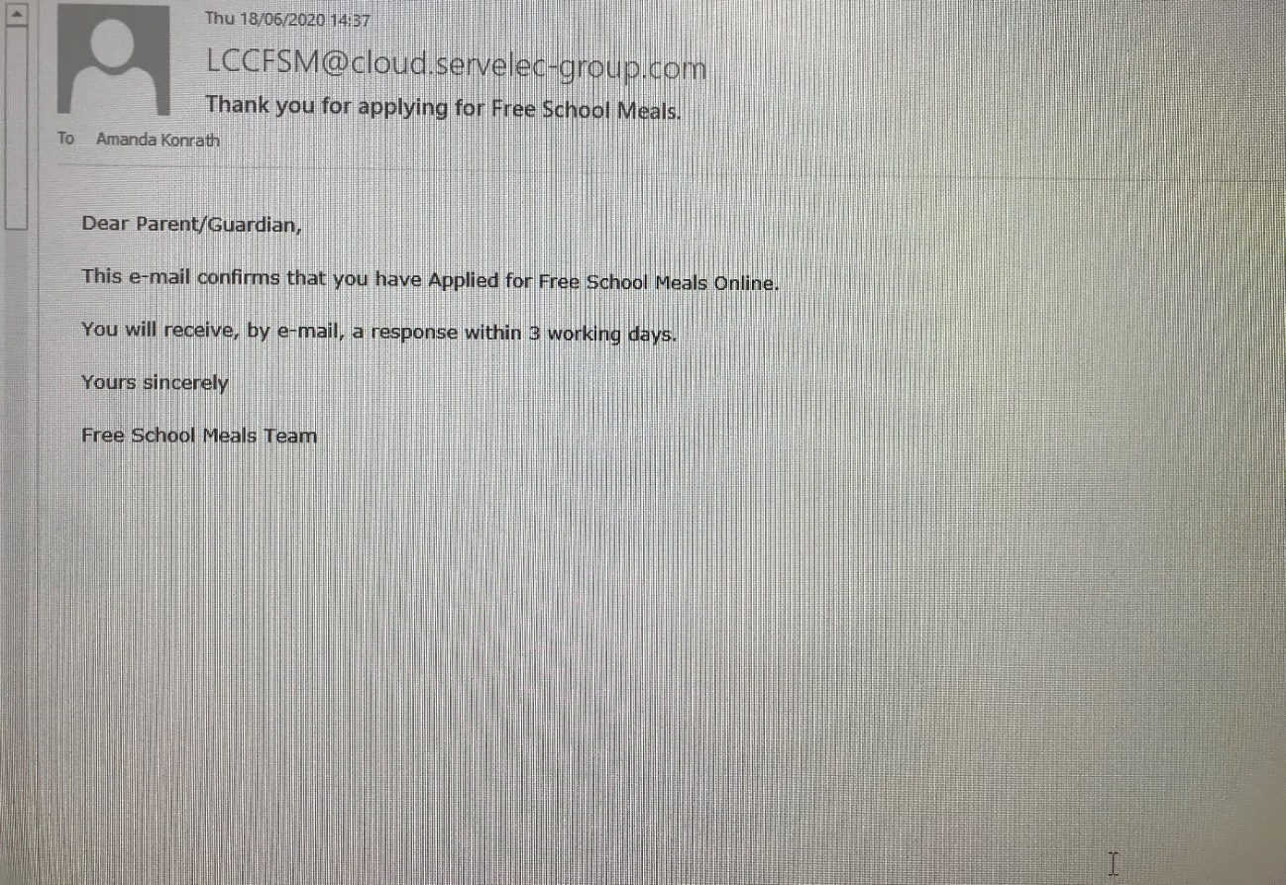
You will receive an email to say that your application was successful. This should come very soon after your application. If you don’t receive this email, please check your application.

Slide 10
Thank you!
I hope that was useful for you.

