Slide 1

Year 1 Maths
FACT FAMILIES

Slide 2
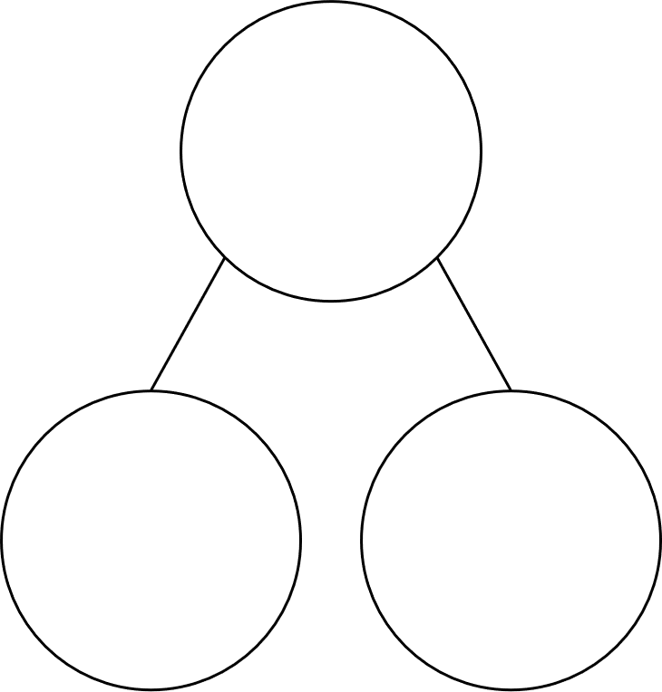

Part-Part whole model
3 + 4 = 7
4 + 3 = 7
7 = 3 + 4
7 = 4 + 3
7
3
4
Please click here to hear more!

Slide 3
Part-Part whole model
6 - 5 = 1
6 - 1 = 5
5 = 6 - 1
1 = 6 - 5
6
5
1
Please click here to hear more!

Slide 4
6 + 2 = 8
2 + 6 = 8
8 = 6 + 2
8 = 2 + 6
8 - 6 = 2
8 - 2 = 6
2 = 8 - 6
6 = 8 - 2
8
6
2
Please click here to hear more!

