Slide 1
s,a,t,p,i,n

Slide 2
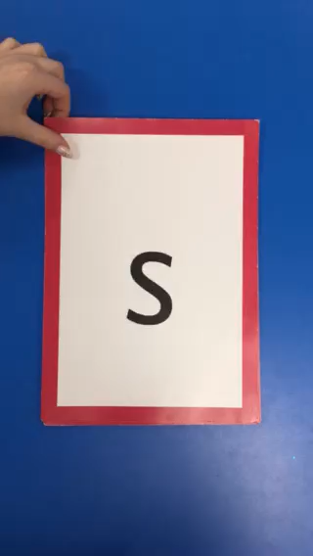

Slide 3
m,d,g,o,c,k,ck

Slide 4
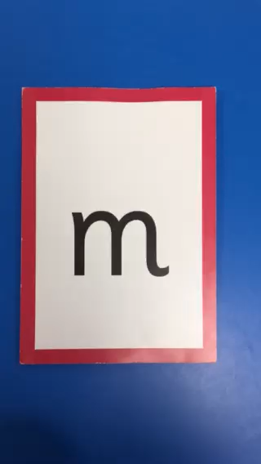

Slide 5
e,u,r,h,b,f

Slide 6
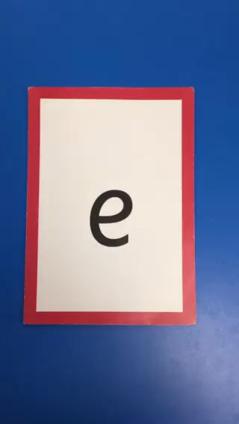

Slide 7
l,j,v,w,x,y,z

Slide 8


