Slide 1
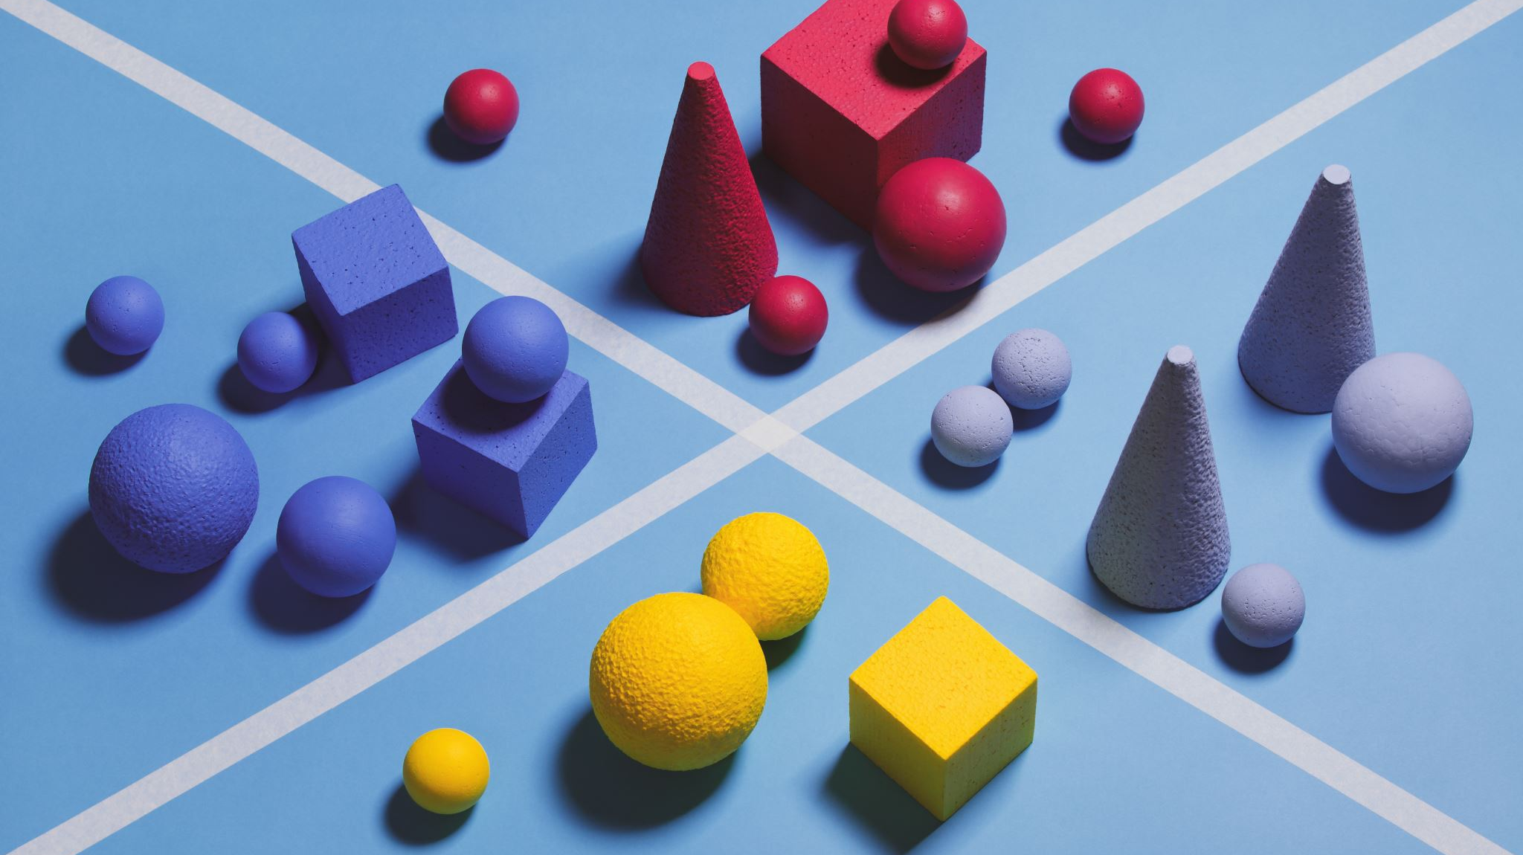
Shapes
2D and 3D

Slide 2

2D Shapes

Slide 3
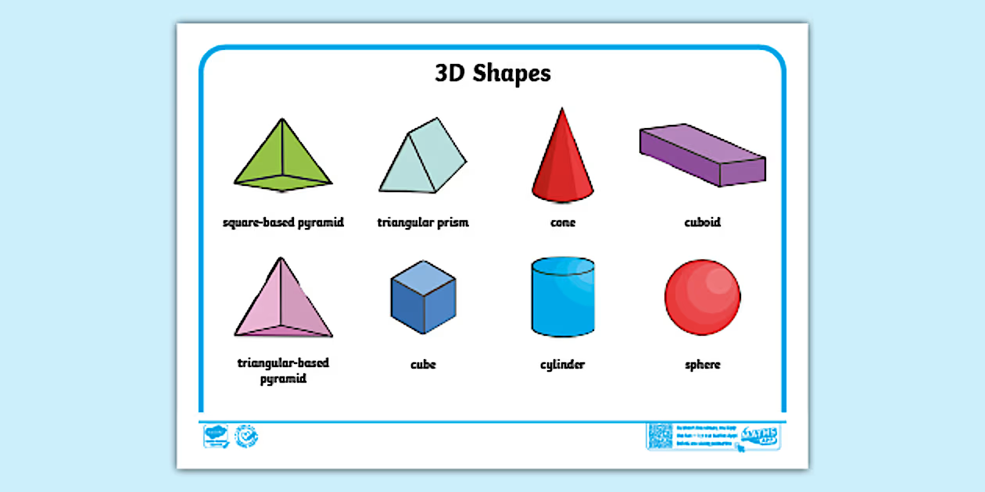
3D Shapes

Slide 4
Shape and Pattern
Our learning around shapes incorporates 2D shapes and 3D shapes and then the shapes of everyday objects. This involves us playing with shape explaining if they would stack or not to make a tower and also roll or slide down a ramp.
We then look at repeating patterns using these. Asking the children to copy a pattern, extend a repeating pattern and then make their own. We talk about a repeating pattern having 2 or more parts.
Here is a 2-part pattern. It has 2 parts that repeat.
Here is a 4-part pattern.

