Slide 1
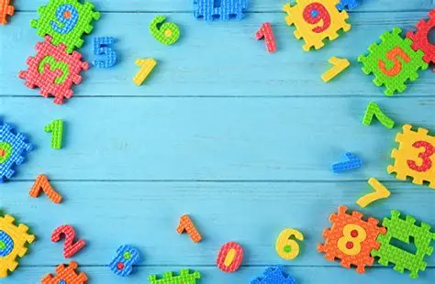

Number bonds to 10

Slide 2
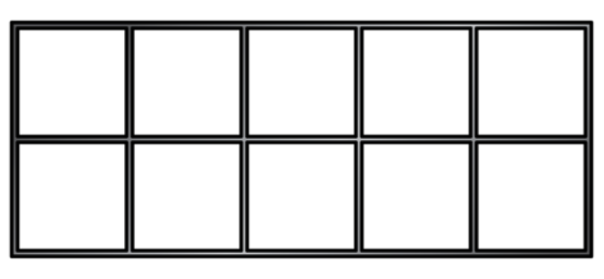
1 + 9 = 10
2 + 8 = 10

Slide 3
3 + 7 = 10
4 + 6 = 10

Slide 4
5 + 5 = 10
6 + 4 = 10

Slide 5
7 + 3 = 10
8 + 2 = 10

Slide 6
9 + 1 = 10
10 + 0 = 10

Slide 7
0 + 10 = 10
0 + 10 = 10
1 + 9 = 10
2 + 8 = 10
3 + 7 = 10
4 + 6 = 10
5 + 5 = 10
10 + 0 = 10
9 + 1 = 10
8 + 2 = 10
7 + 3 = 10
6 + 4 = 10

