Slide 1

End of Key Stage One Assessments 25-26

Slide 2
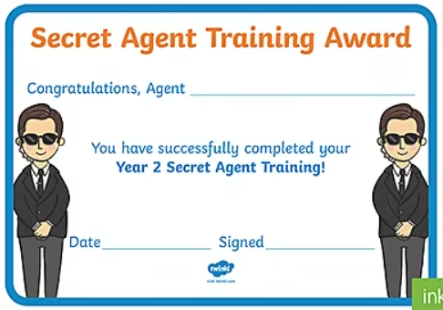
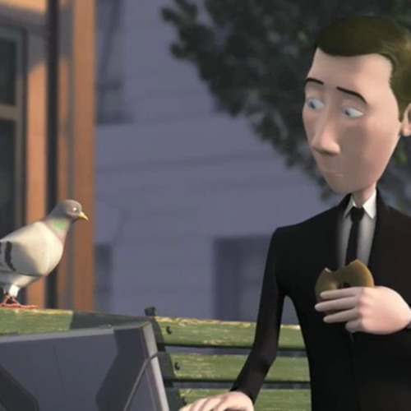

Secret Agent Training
Walter the spy against the pigeon in Pigeon Impossible.
Notes:
This year, we will be having an assessment week rather than taking the optional SATs papers.
We will still introduce the week as Secret Agent Training as this is an exciting hook to the week.
The children start the week by making code names and watching Pigeon Impossible which is a short Pixar film. – PLEASE DON’T WATCH IT AT HOME

Slide 3
Assessment Week
Week beginning 8th June
One week to provide additional activities focusing on reading and maths to aid our end of year teacher judgements.
At the end of the year in your child’s written report, we will report whether your child is working towards, working at the expected standard for KS1 or working at greater depth within the expected standard.

Slide 4

Reading
During the week, the children will continue to take part in reading groups. This may be with their class teacher or with another class teacher from the year group.
Some children will complete one or both of the reading papers.

Slide 5

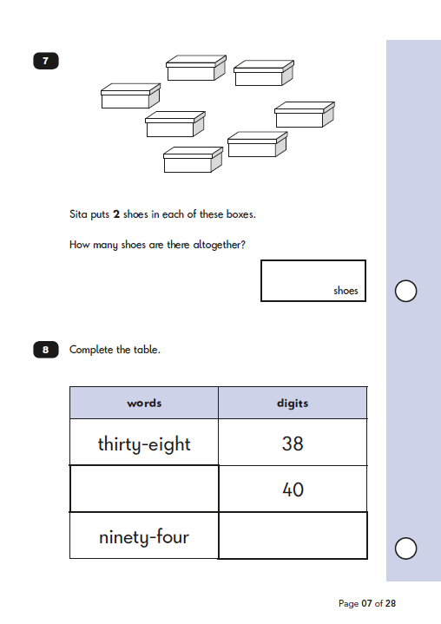
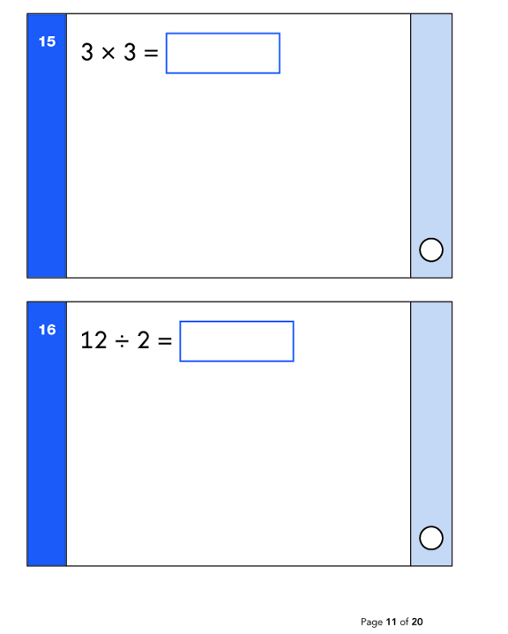
Mathematics
There are 2 papers in maths: Arithmetic and Reasoning.
Like last year, some children will do one or both papers. We will have additional activities and lessons should some children need extra practise with a particular area of maths.

Slide 6

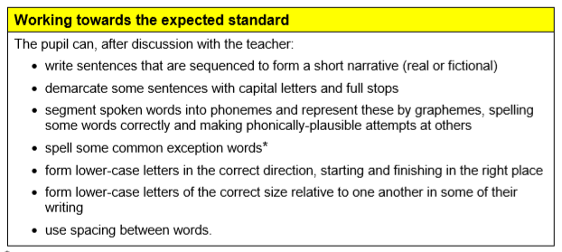
Working towards the expected standard
There was never a writing SATs paper so evidence in your child’s writing book will be used throughout the year to track their progress.
These statements are what we look for in writing if your child is working below age related – at the end of year two.
Notes:
As there is no writing paper, we would like to take this opportunity to share with you the end of year expectations for KS1.
Following our last parents evening, you would have received assessment information and know where your child is working in Reading, Writing and Maths in Spring. We will assess your children for the final time half way through the next half term and this information will be shared in their school report.
These is the outline of what a child can do if they are working towards the expected level.

Slide 7
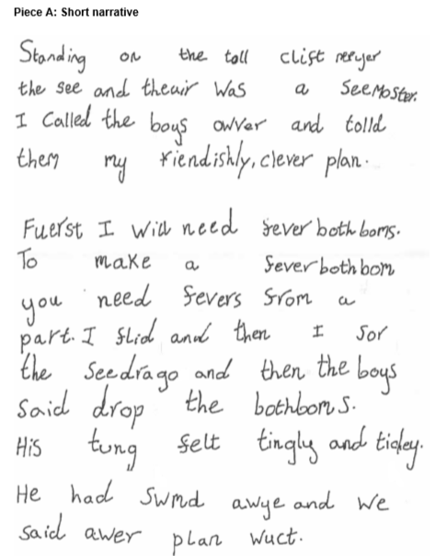
Working towards the expected standard in Writing
End of year two example

Slide 8
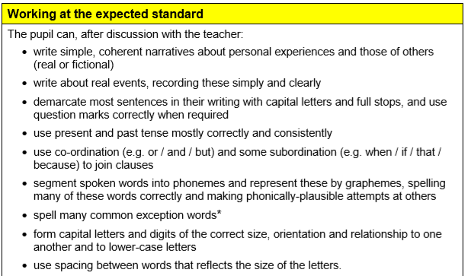
Working at the expected standard
There was never a writing SATs paper so evidence in your child’s writing book will be used throughout the year to track their progress.
These statements are what we look for in writing if your child is working at age related – at the end of year two.

Slide 9
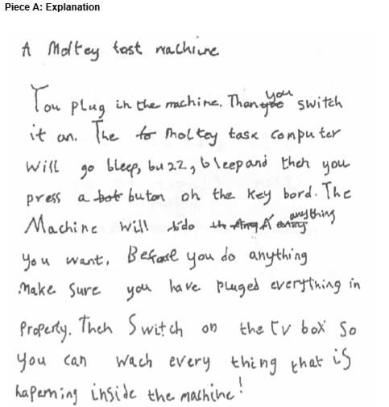
Working at the expected standard in Writing
End of year two example

Slide 10
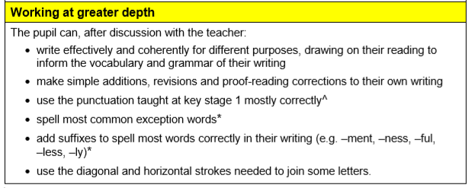
Working above the expected standard
There was never a writing SATs paper so evidence in your child’s writing book will be used throughout the year to track their progress.
These statements are what we look for in writing if your child is working above age related – at the end of year two.

Slide 11
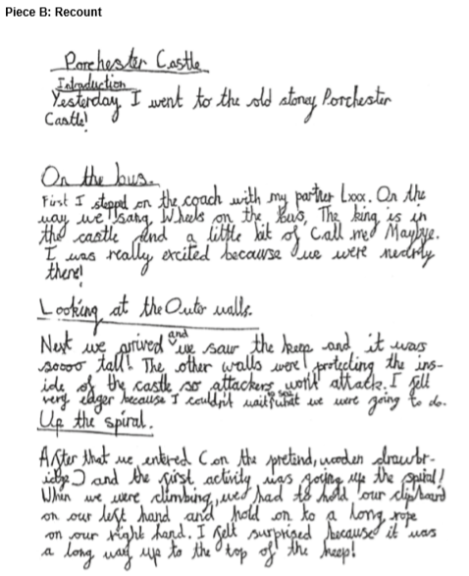
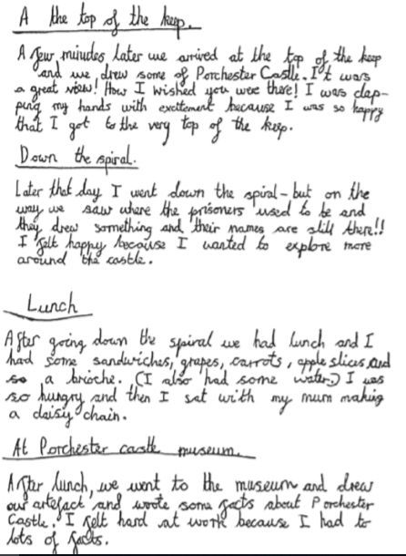
Working above the expected standard
End of year two example

Slide 12
How can I help my child?
Treat the week like any other week in school!
Listen to your child read daily. Ask questions and talk about what they have read. Make sure they understand what they are reading by ensuring they read with appropriate pace.
Remember that good readers become good writers.
Use online activities like ictgames.com, White Rose Maths (parent’s section) to practise skills at home.
Play timetable games, telling the time, using money in the shop and helping in the kitchen when measuring out ingredients.
Contents

Slide 13
 | Session 1 | Session 2 | Afternoon
Monday | Hook session – name card, Pigeon Impossible | Maths focus | Crack the code activities
Tuesday | Maths focus | Maths focus | Protect the egg – team building activity
Wednesday | Reading focus | Reading focus | Baking/food activities
Thursday | Reading focus | Reading focus | PE activities
Friday | Additional time if needed
Here is an example of what the week may look like.
Each day will have an activity linked to Pigeon Impossible.
This will also include writing activities.

Slide 14
Any questions?
Please send an email to school, enquiries@st-faiths.lincs.sch.uk if you have any questions.
Thank you.

