Slide 1

St Faith’s Church of England Infant and Nursery School
Transition meeting for Parents
Year 1 to Year 2 2026

Slide 2
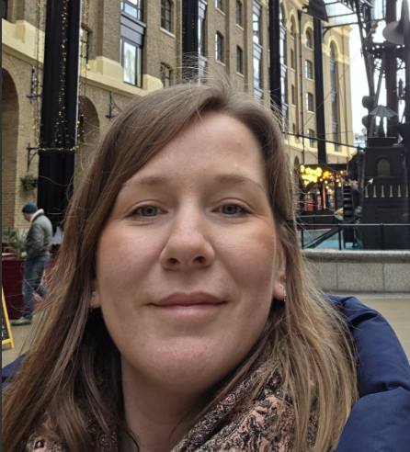
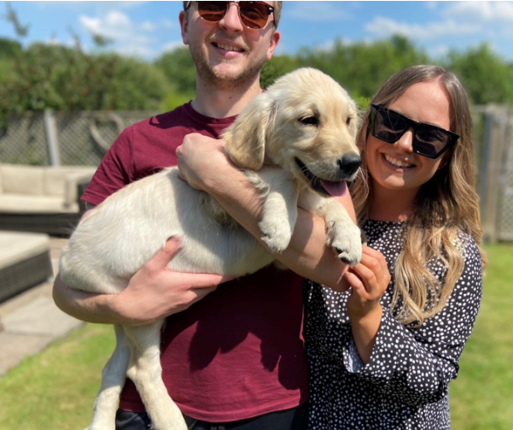
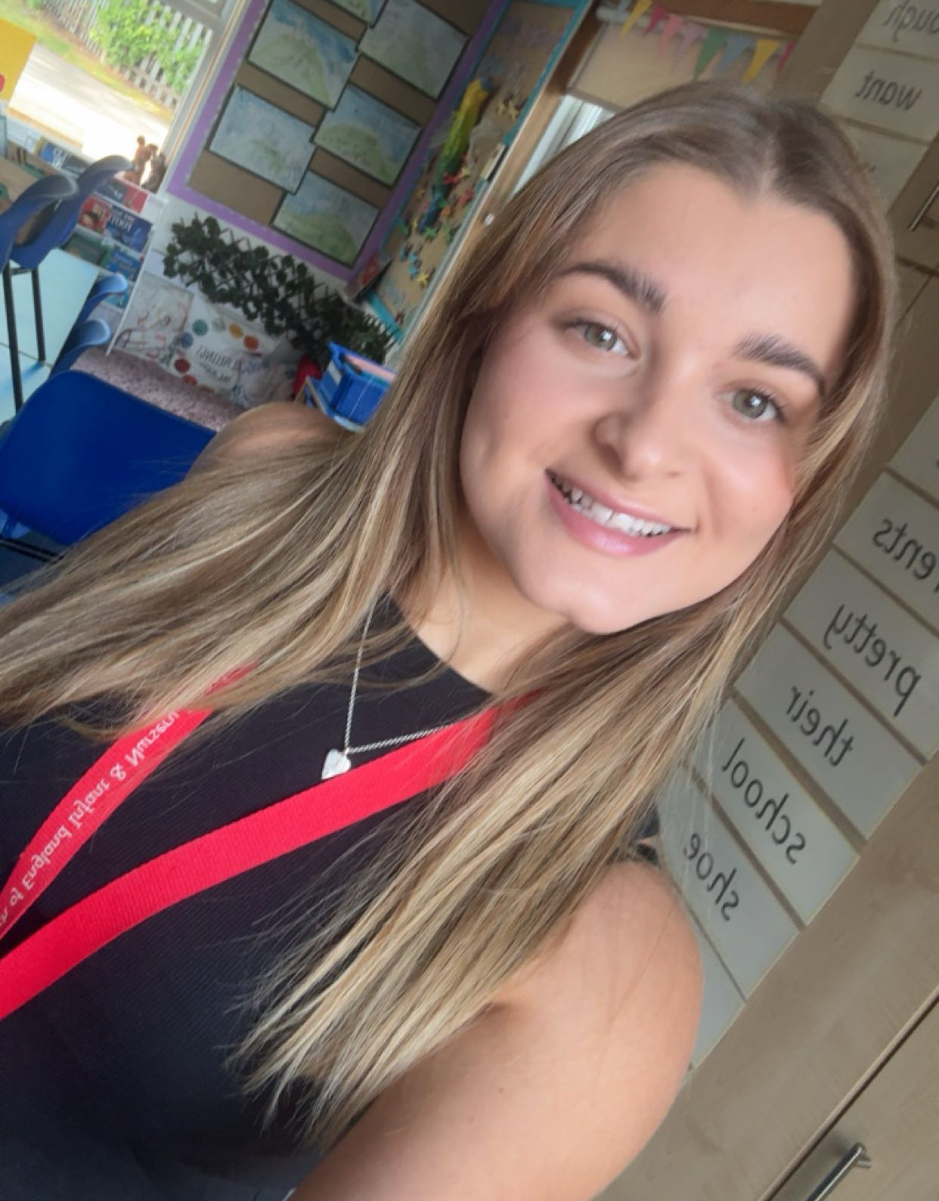

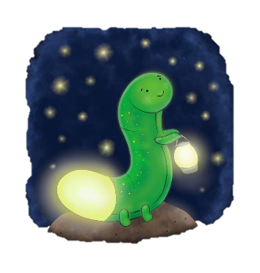

Who’s Who?
Mrs Desforges
Mrs Wallis
Miss McGinty

Slide 3
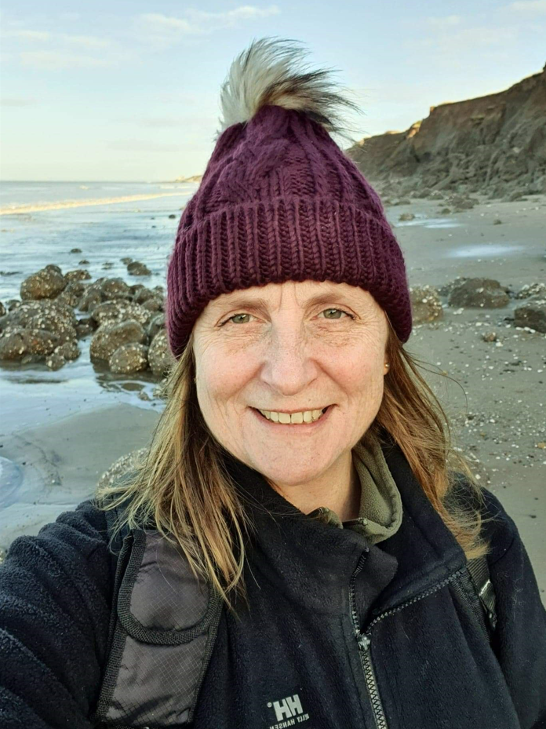
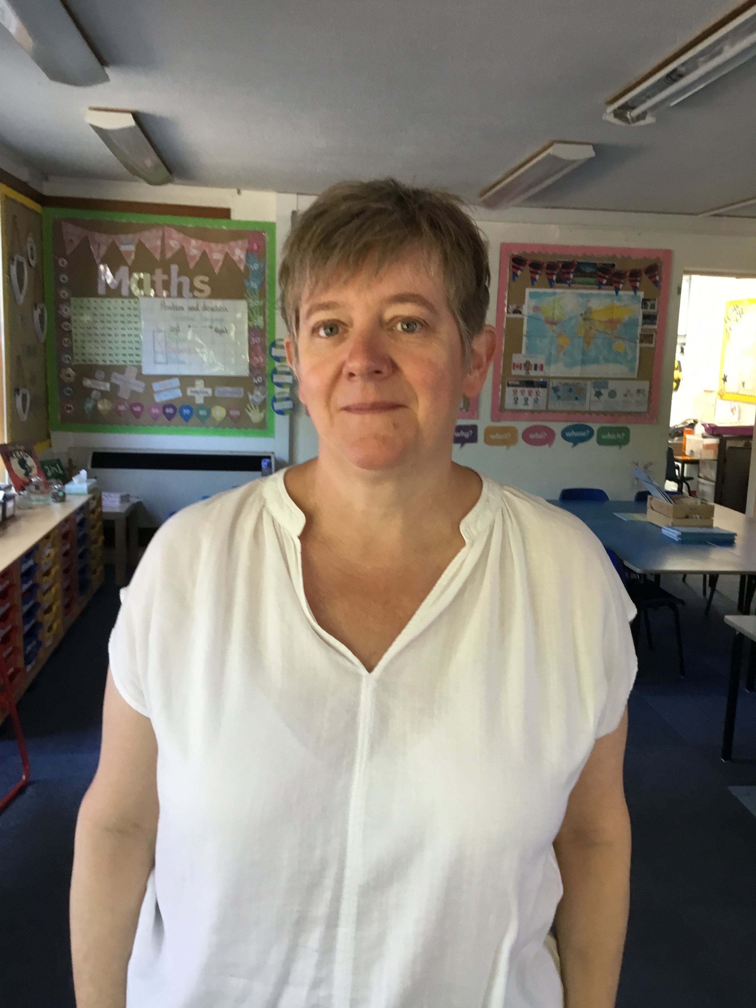
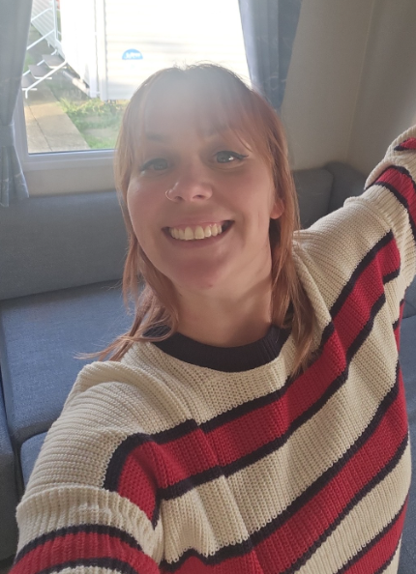
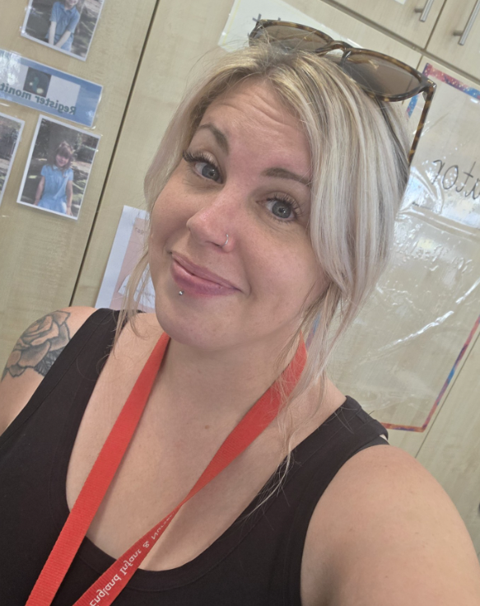
Meet our TAs
Mrs Jones
Mrs Hooton
Miss Lane
Miss Maksymiw

Slide 4















Key Stage 1 National Curriculum
Just like in Year One, the children will have topic sessions. These happen in the afternoon sessions and sometimes during English as a cross-curricular link.
Notes:
RE
PE
Music
Computing

Slide 5
What is it like to be in Year 2?
The children are dropped off at the classroom door.
They will usually have a morning task or reading when they first come into class.
We encourage children to have a healthy snack at playtime, either fresh fruit or vegetables. We do provide a snack option. We are a NO NUTS.
We ask that all children bring in water bottles for during the day.
The children will be asked if they would like a monitoring job such a handing out registers and fruit to the school. We change every half term.
Your child may get the opportunity to be a team captain, School councillor, Worship council or Digital Leader.

Slide 6

What can we do as parents to help?
Your child will be sent home spellings weekly. These link to the words they must be able to spell by the end of Year 2. Children will get a team point if they practise.
Practise spellings in their reading diary.
Read at least 3 times a week and record in their diary. Make sure that their book and diary are in school every day.
We will be continuing with the Schools & Families Numeracy Challenge. Your child will receive a scrapbook and a maths activity every two weeks – information to follow
Your child can log in to Natterhub to show learning or access quizzes.

Slide 7
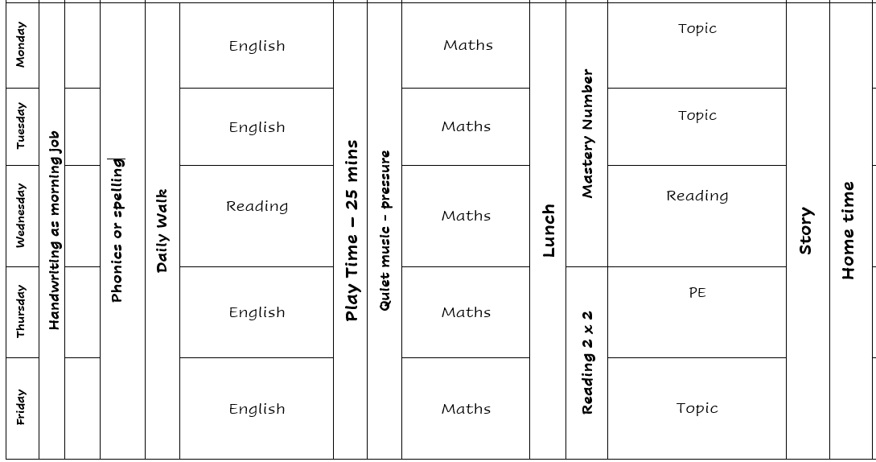
Being a Y2 continued…

Slide 8
Possible School Trips
We thought it would be useful to give you an idea of school trips that may take place this. Please note the costs are based on this year and will probably alter slightly.
Autumn Term:
Library visit – free (we will go to the library a couple of times in the school year)
Spring Term:
Cathedral trip - £7.50
Summer Term:
Wildwood and Cinema trip – The PTA have funded the cinema trip. £7.50
Hartsholme Park - £6.85
Visitors - Fire safety, Internet Safety, Emotions workshop, (No cost)

Slide 9
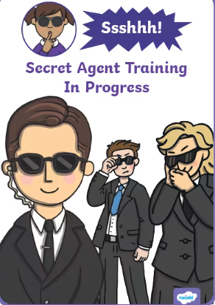
Assessment
Optional SATs – informal, relaxed activities.
When talking to the children, we often call them ‘Secret Agent Training’.
There are 2 reading papers and 2 maths papers.
We always assess throughout the year.
SATs are used to inform our teacher assessments.
There will be an additional parent chat later in the year.

Slide 10
How we help your child settle?
Teachers meet to handover information about each child.
We have arranged story times with our new classes before the holidays.
Children will receive a letter from their new teachers and Teaching Assistants telling them a bit about themselves.
In September, the transition to Year 2 is gradual.
We are aware they are still little ☺

Slide 11
How can I help my child get ready for Year Two?
Talk enthusiastically about being a Year Two!
Talk to them about what they have learned in school.
Independence – getting ready for school and remembering own book bag and water bottle.
Reading with your child as much as you can and writing in your child’s reading book when they have read.
Practising your child’s spellings with them
Look at the Year 2 pages on the school website and follow the school Facebook page to keep up to date with what year 2 are up to.
Please make sure that all clothing is named. Children need their PE Kits in school every day, in a named bag.

Slide 12
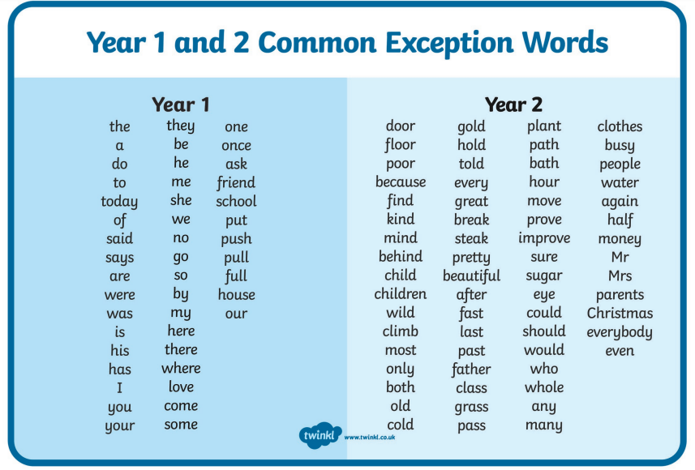

Slide 13
Staying in touch…
Check out the school Facebook page and website for updates.
Newsletters will be sent out every half term.
Login to your Natterhub Parent login
Family progress meetings twice a year. Please chat to your teacher about any concerns as they arise ☺
Drop ins to see your children’s workbooks.
Family reading sessions
There will be parent chats throughout the year including SATs, Maths and Talk 4 writing.

Slide 14
Date:
Tuesday 30th June after school
Informal drop-in to your child’s new classroom
Any Questions?
☺

